Slide 1
Version Control System
:- Pulkit Dhingra

Slide 2
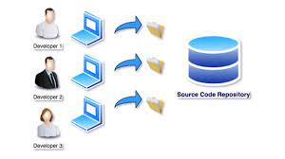
Source Code Repository
A source code repo is a space to store the code. It is a file archive and web hosting facility where programmers, software developers, and designers store large amounts of source code for the software and/or web pages for safekeeping.

Slide 3
Version Control System Types
Centralized Version Control
With centralized version control systems, you have a single “central” copy of your project on a server and commit your changes to this central copy. You pull the files that you need, but you never have a full copy of your project locally.
Eg CVS subversion.
Distributed Version Control
With distributed version control systems (DVCS), you don't rely on a central server to store all the versions of a project’s files. Instead, you clone a copy of a repository locally so that you have the full history of the project. A common distributed version control systems are Git.

Slide 4
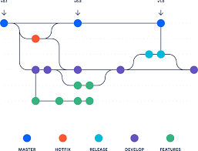
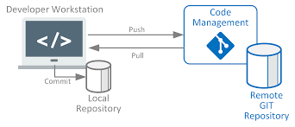
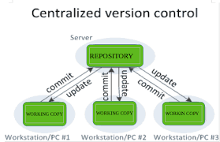
Benefits of using VCS
Versioning the code
Single space for the code
Usage tags and version names
Rollbacks
Keep a record of changes

Slide 5


Versioning the code
Branch 1
Version 2
Rollback
Developer 1
Code Repository
Branch 2
Version 2
Developer 2
Developer 3
Branch 3

Slide 6
What is GIT ?
Command line VCS
Open Source
Distributed Version Control System
Created by Linus Torvalds,2005
Cross Platform

Slide 7
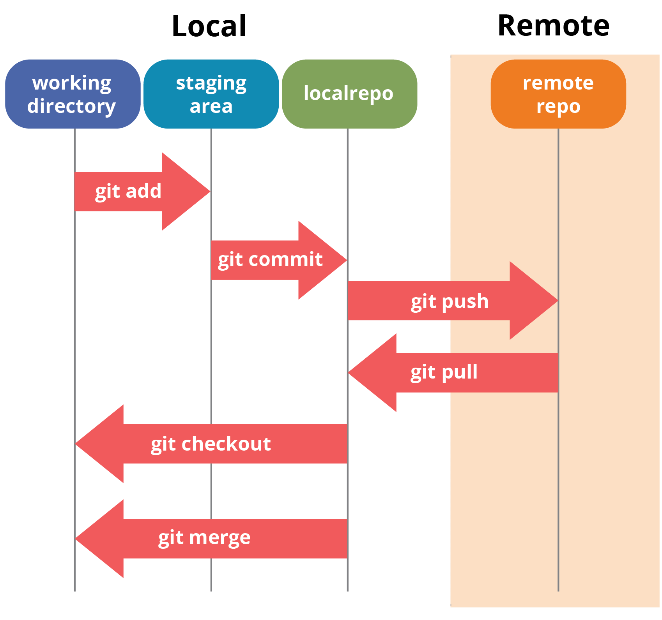
Storing source code in Git repository

Slide 8
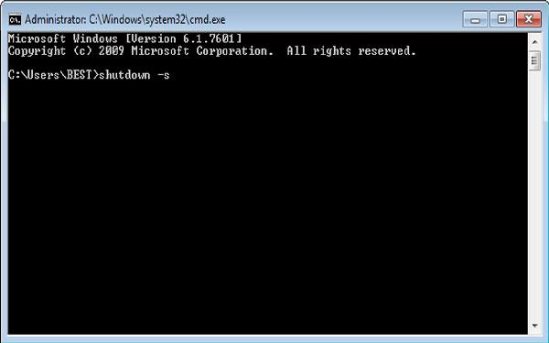

Ways to work in Github
Using Command Line
Using the interface

Slide 9
Some Important Git Commands
Git init Initializes a new Git repository. If you want to place a project under revision control, this is the first command you need to learn.
Git Clone Creates a copy of an existing Git repository. Cloning is the most common way for developers to obtain a working copy of a central repository.
Git Add Moves changes from the working directory to the staging area. This allows you to prepare a snapshot before committing it to the official history.
Git Commit Takes the staged snapshot and commits it to the project history.

Slide 10
Git Push
Push the changes into the repository branch
Git Pull
Pull the changes from a github repository to local.
Git Log
Provides logs of previous revisions of the repository
Git Branch
Used to create branches within the repository
Git Merge
It is used to merge the code of two branches.
Git Status
Displays the state of the working directory and the staged snapshot.

